Slide 1
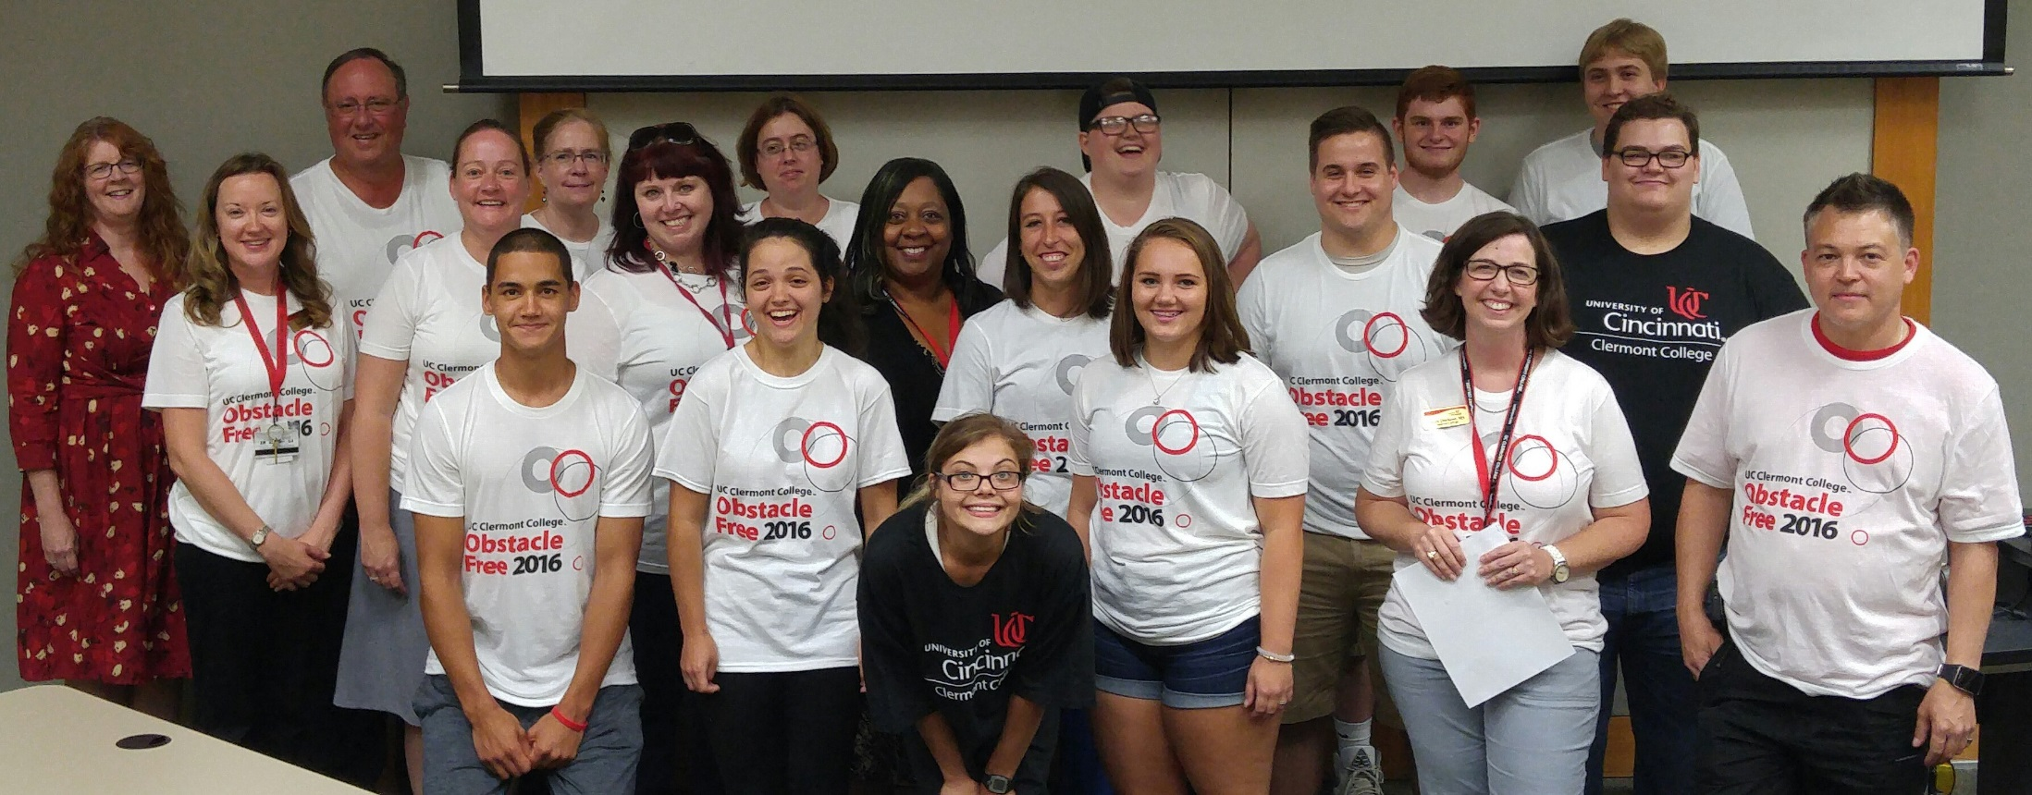
ANNUAL REPORT FY 2015-2016
UC Clermont Testing Services www.ucclermont.edu/students/testing-services

Slide 2
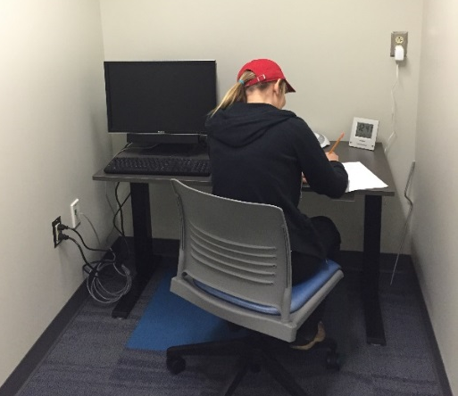
affordable, accessible, student-centered
Clermont College
Testing Services
Situated on 91 beautifully wooded acres in Batavia Township the University of Cincinnati Clermont brings the power of UC to Clermont County. We strive to be a partner by providing resources and opportunities for education and enrichment.
UC Clermont has some of the most affordable tuition in the state of Ohio – less than half the cost of most other colleges and universities. Scholarships and financial aid help make the cost of college education that much more affordable at UC Clermont.
More than 3,000 students are enrolled at UC Clermont College in more than 50 academic programs at the undergraduate level. As an open admission institution, we accept everyone with a high school diploma, GED or equivalent.
Mission
UC Clermont College provides student-centered undergraduate education and life-long learning in an open-access, regional college environment. We foster diversity as well as intellectual, cultural, and social development in our community.
Vision
UC Clermont College will become the first choice for students who seek quality undergraduate degree opportunities which are accessible and affordable. We endeavor to respond to community needs and to foster lifestyles which are sustainable, culturally rich and rewarding.
Testing Services is a unit within the Academic Affairs Office which is responsible for oversight of all academic functions of the College. Academic Affairs works with the college's five academic departments on program development, student outcomes assessment, program assessment, data collection and analysis, outreach, and course scheduling.
Testing Services Mission
Testing Services is dedicated to enhancing student learning by providing comprehensive, accessible testing services to meet the increasing needs of students, faculty, administrators and community members while maintaining test integrity. Testing Services maintains membership with and adheres to the Professional Standards and Guidelines set forth by the National College Testing Association (NCTA).
Contact Information Phone: (513) 732-5219 E-mail: clctest@uc.edu
Hours and Location Peters-Jones Building Suite 103 Monday – Friday 9am – 5pm Evening Options Tuesday 5pm – 8pm Wednesday 5pm – 8pm

Slide 3
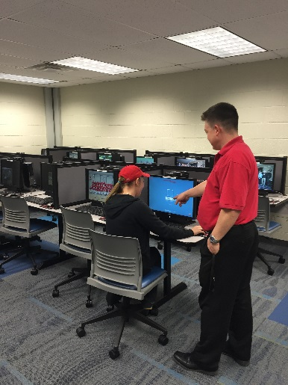
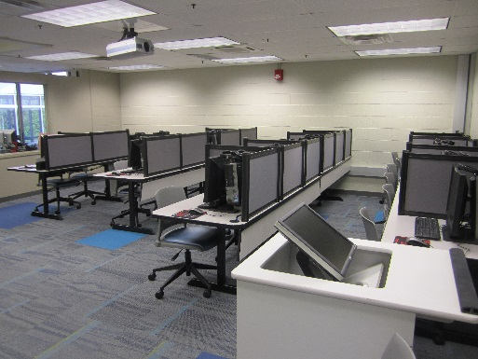
partnerships, community outreach
On-campus partnerships
Clermont College Testing Services partners with the following on-campus offices to provide a variety of services to students:
Office of Disability Services by providing proctoring services to all students who receive testing accommodations.
Offices of Recruitment, Academic Advising and OneStop by providing placement testing to incoming students prior to advising and registration.
Academic Program Departments by providing admissions, exit and certification exams for academic program initiatives.
College Credit Plus Program by proctoring admissions testing to high school students as part of the application process.
College Success Program through initial identification of program participants.
Community Outreach
Clermont College Testing Services also offers services to the community by providing:
PearsonVue exams which include GED, CISCO, CompTIA, Ohio Educators Assessment and much more.
Exams for college-credit including the College Level Examination Program (CLEP) and Prometric DANTES (DSST).
Proctoring services for students in online courses either through the University of Cincinnati or outside the University.
Quiet testing space for students needing accommodations on any of the tests above.

Slide 4
highlights
Administered 2,007 exams (9% increase from 2014-2015).
Generated revenue of $5,920.21.
Increased placement test completion rate to 98% of entering Freshmen.
Increased use of students with Disabilities by 50.8%. (317 appointments in 2014-2015 versus 576 in 2015-2016)
Presented at OCTA regional conference and NCTA national conference:
How to Re-Imagine Testing Services (Julie Eagen & Brandon Woo)
Including Testing Services in the Retention Effort (Julie Eagen & Lesley Dorhout)
Received $10,000 Diversity and Inclusion Grant to hold Obstacle Free 2016 program in partnership with College Success Program.
Applied for NCTA Test Center certification.
Managed attendance at summer Orientation sessions.

Slide 5
summary
Test Offerings
ATI TEAS V – Physical Therapist Assisting
Beacon Student Strengths Inventory
Certiport
College Level Examination Program (CLEP)
Evolve HESI – Medical Assisting
National Board of Surgical Technology and Surgical Assisting Certification Exams
PearsonVue
Prometric - DANTES (DSST)
Questar Assessment Inc., Degrees of Reading Power
TypingMaster
University of Cincinnati English and Math Placement Exams
WebCAPE Foreign Language Placement Test
Proctoring Services
Students registered with Disability Services
Students in online courses within the UC system and outside the UC System

Slide 6
Goals 2016-2017
Create Student Learning Outcomes and assessment measures for 4 services offered by Testing Services.
Revise Placement Test survey to include questions about staff performance and customer service.
Increase revenue specific to Distance Learning proctoring. Reach out to faculty teaching online courses through UC.
Increase numbers of students registered with Disability Services who utilize Testing Services for test proctoring. Partner with Disability Services to promote use.

